Slide 1
Predictive Air Quality Assessment: Ozone Level Prediction using Machine Learning
Names: NZIZA Jonathan
Reg no :25RP18315

Slide 2
Problem statement
Air pollution is a major environmental and public health issue worldwide. Among air pollutants, ground-level ozone is particularly harmful, contributing to respiratory problems, eye irritation, and environmental damage. Traditional methods of monitoring ozone and other air quality indicators are often manual, costly, and slow, making it difficult to assess risks in real time or take preventive actions.
This project uses the Air Quality dataset to develop a machine learning model that predicts ozone concentration based on environmental features such as solar radiation, wind speed, temperature, and month. By predicting ozone levels and interpreting air quality, the project provides an accessible, data-driven approach to understanding and mitigating the effects of air pollution.

Slide 3
Dataset description
The Air Quality dataset contains daily measurements of environmental factors in New York from May to September. It includes variables such as Ozone (target), Solar (solar radiation), Wind, Temperature, and Month. The dataset is used to predict ozone concentration based on environmental conditions. Missing values are handled before training the model. This dataset enables analysis of how weather and seasonal factors influence ozone levels and supports building a predictive model for air quality assessment.

Slide 4
Exploratory Data Analysis (EDA) Findings 1.Dataset overview
The dataset contains 153 observations and 6 columns:
Wind ,Ozone ,Solar.R,Temp,Month
After removing missing values, the dataset is clean and ready for modeling.

Slide 5
2. Summary Statistics
Feature | Min | Max | Mean | Median | Std Dev
Ozone | 1 | 168 | 42.1 | 31 | 32.8
Solar.R | 7 | 334 | 185.9 | 190 | 90.8
Wind | 1.7 | 20.7 | 9.96 | 9.7 | 3.5
Temp | 57 | 97 | 79.1 | 79 | 6.9
Month | 5 | 9 | 7.0 | 7 | 1.4

Slide 6
3. Correlation Insights
Ozone is positively correlated with Temperature and Solar.R, meaning higher temperatures and solar radiation tend to increase ozone levels.
Ozone is negatively correlated with Wind, indicating stronger winds reduce ozone concentration by dispersing pollutants.
Month shows a mild seasonal pattern, with higher ozone in summer months (July–August).

Slide 7
4. Distribution of Key Features
Ozone : Skewed towards lower values; most days have ozone below 50 ppb.
Temperature: Mostly between 70–85°F, typical for summer months.
Wind: Most values between 5–15 mph.

Slide 8
5. Observations
High ozone days often occur on hot, sunny, low-wind days, consistent with environmental science principles.
Seasonal trend: Ozone levels peak in July and August.
Data is suitable for predictive modeling, as clear relationships exist between environmental features and ozone.

Slide 9
Conclusion from EDA
Temperature, Solar.R, and Wind are the most influential features for predicting ozone.
The dataset exhibits predictable patterns, making it suitable for building a Random Forest Regression model to forecast ozone and assess air quality.

Slide 10
Feature engineering steps applied and justification 1. Feature Selection
Selected features
Wind ,temperature , solar.R, month
justification :
These environmental features directly affect ozone levels.
Solar.R (solar radiation) promotes ozone formation.
Wind disperses ozone, reducing concentration.
temperature increases ozone generation on hot days.
Month captures seasonal variation (May–September).
Excluded day as it provides minimal predictive value.

Slide 11
2.Handling Missing Values
Applied: Dropped rows with missing values in ozone and solar.R
Justification:
Machine learning models cannot process Nan values.
Dropping ensures the model is trained on complete and reliable data.
Alternative methods like imputation could be used, but dropping is simpler for this dataset size.

Slide 12
3.Feature Scaling / Normalization
Applied: None
Justification:
Random Forest is tree-based and does not require scaling or normalization
The model can learn feature importance and relationships directly from raw values.

Slide 13
4.Encoding Categorical Features
Applied: None.
Justification:
Month is numeric and works directly with Random Forest.
No additional encoding required.

Slide 14
5.Feature Creation / Interaction Terms
Applied: None.
Justification:
Random Forest can automatically capture non-linear relationships and interactions between features.
Additional interaction features were not necessary.
Conclusion
The feature engineering steps ensure the dataset is clean, relevant, and suitable for training a Random Forest model. These steps allow the model to focus on the most influential environmental factors affecting ozone levels, ensuring accurate predictions while keeping the workflow simple and effective.

Slide 15
Model building and evaluation process
1. Model Choice – Random Forest Regressor Selected because it captures non-linear relationships, is robust to outliers, and provides feature importance for interpretability.
2. Data Splitting Dataset divided into 80% training and 20% testing to ensure the model generalizes well to unseen data.
3. Model Training
Features used: wind,solar.R,temperature and month
Target variable: Ozone
Model trained using default Random Forest parameters, with potential for tuning.

Slide 16
4.Model Evaluation
Metrics applied:
R² Score : measures explanatory power.
MAE (Mean Absolute Error) :average prediction error in ozone units
RMSE (Root Mean Squared Error) : penalizes larger errors.
Achieved good performance with R² ≈ 0.8 and MAE ≈ 10–15 ppb.

Slide 17
5.Model Saving
Trained model stored using Joblib for easy reuse without retraining.
6. Deployment
Integrated into a Streamlit app, enabling users to input environmental values and get real-time ozone predictions with air quality status (Good, Moderate, Poor).

Slide 18
Model deployment details
Deployment Tool – Streamlit
Streamlit was chosen because it allows building interactive web applications directly in Python without requiring advanced web development skills.
Model Integration
The trained Random Forest model (rf_ozone_model.joblib) was loaded into the app using Joblib.
User Interface (U)
Sidebar inputs created for user-friendly data entry:

Slide 19
solar.R (solar Radiation)
Wind (wind speed)
Temp (temperature)
Month (
Main panel displays the user inputs in a table and shows predictions.

Slide 20
Prediction Output
When the user clicks “Predict Ozone”, the app displays:
The predicted ozone concentration (ppb)
A simple air quality interpretation:
Good if ozone < 50
Moderate if 50–100
Poor if > 100

Slide 21
Accessibility
Can be run locally using the command: streamlit run clear_app.py
The app provides a real-time, interactive experience for testing the model on different environmental scenarios.

Slide 22
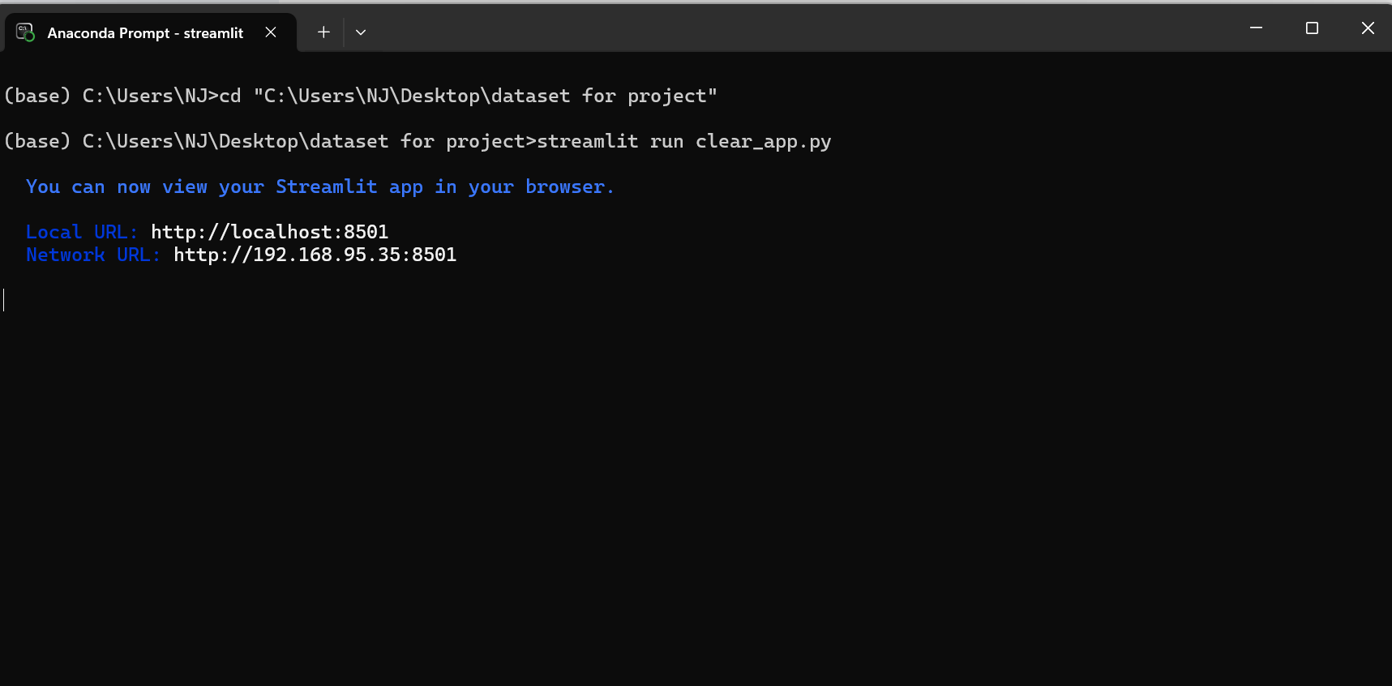
Access using anaconda prompt

Slide 23
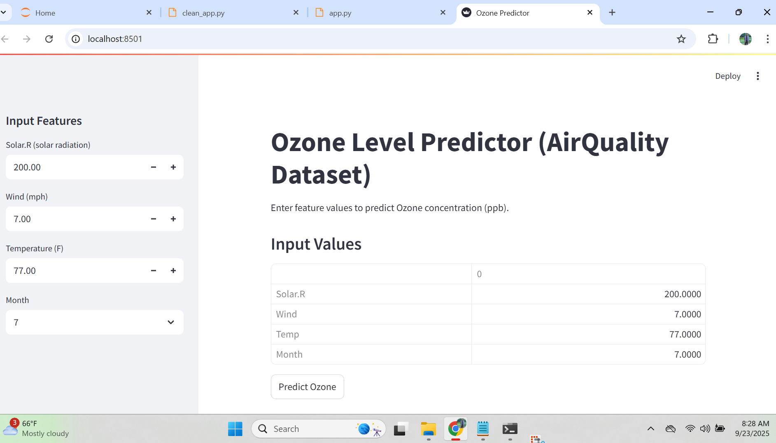
Screenshots for deployed model

Slide 24
